Slide 1
Plate Cleanliness Detection
By Stanley Hsieh and Fang Wu
CSS487 Fall 2023

Slide 2
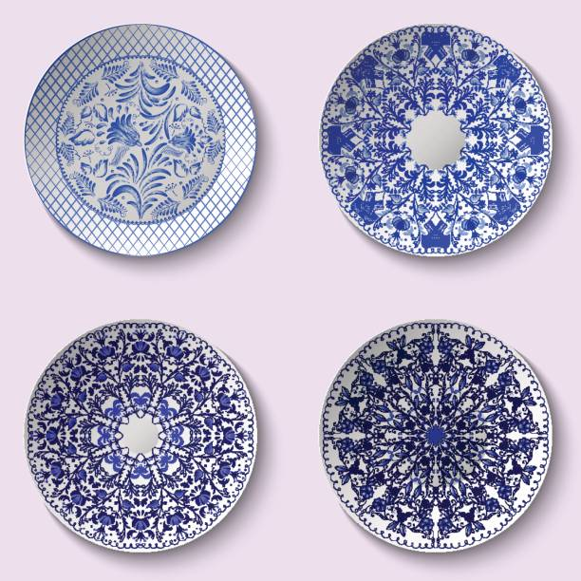
Overview
Our program should detect and draw a box around each plate present in the image.
Categorize the plates as white plates or plates with a pattern.
After the plates are detected and categorized, it should be able to classify them as clean or dirty plates.

Slide 3
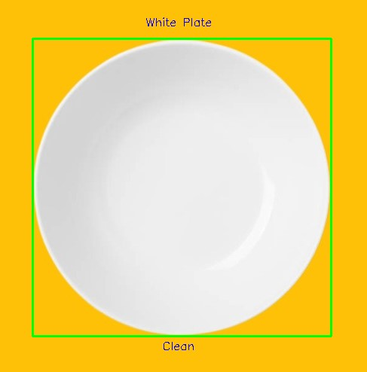
Method
Version 1:
Read image
Run plate detection:
Grayscaling
Gaussian blur
Canny edge detection
Dilation
Find contours
White/Pattern plate detection:
Create color histogram
Find most common color
Cleanliness detection:
White Plates
Create hsv image -> calculate mean intensity -> compare to threshold
Pattern Plates
Gray scale image -> calculate mean intensity –> compared to threshold

Slide 4
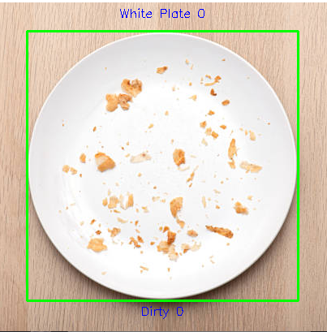
Version 1 output for white detection:

Slide 5
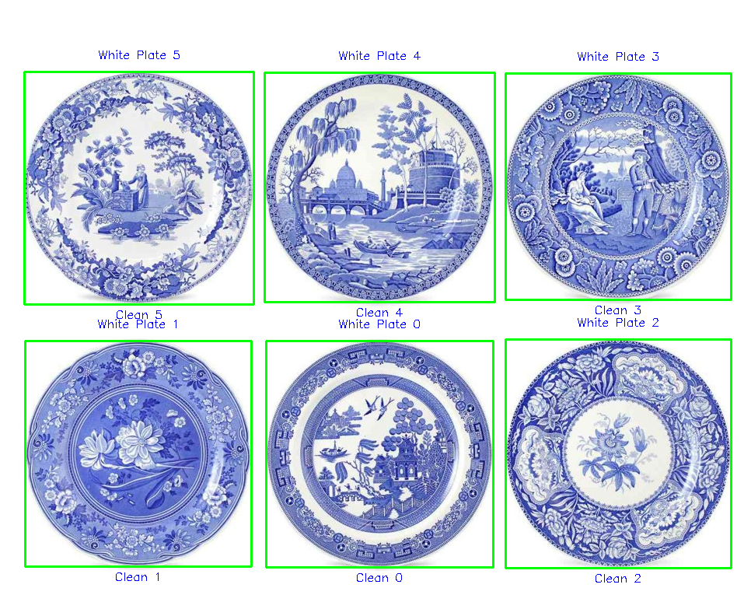
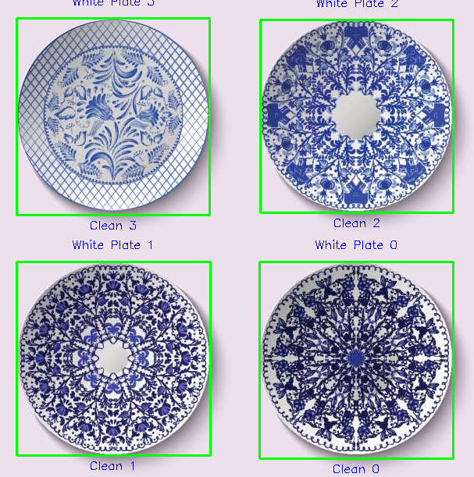
Version 1 output for white detection:

Slide 6
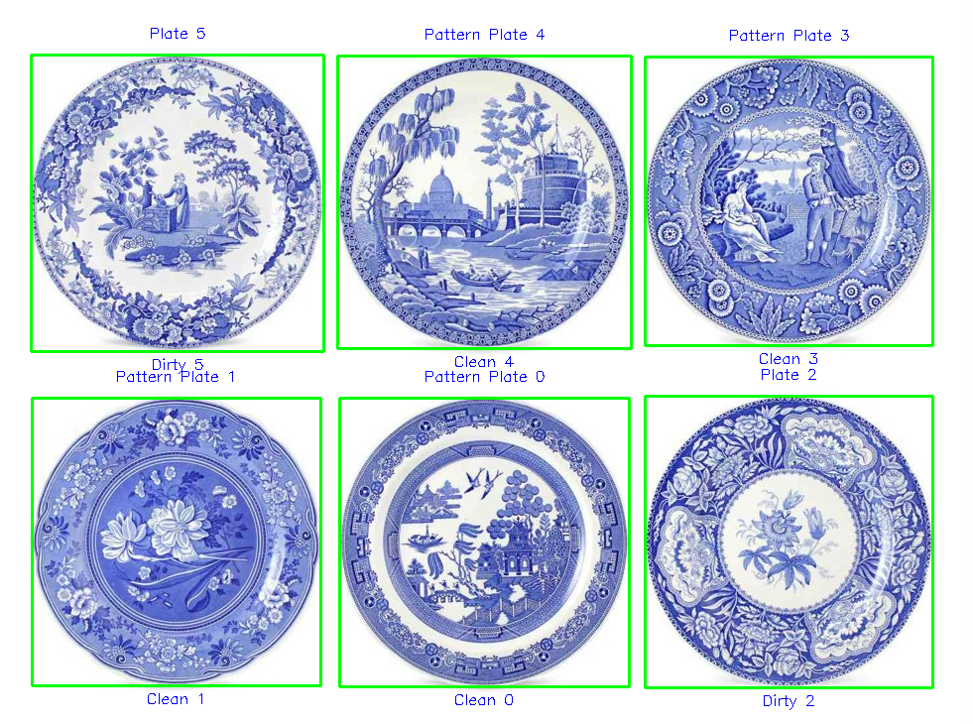
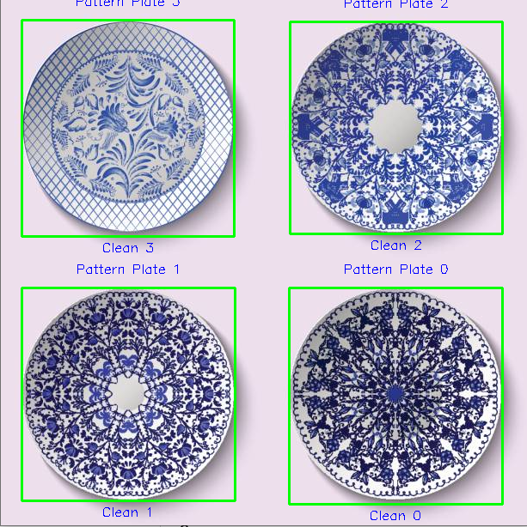
Version 1 output for pattern detection:

Slide 7
Method
Version 2:
Read image
Run plate detection:
White plate detection:
Loop over all the pixels and count pixel that in white range
Find and white percentage then compare with the threshold
Pattern plate detection:
SIFT detector
Cluster keypoints using k-means
Check clusters for evenly distributed and similar in size
Cleanliness detection:
White Plates
White pixel detection -> percentage -> compared to threshold
Pattern Plates
Gray scale image -> calculate mean intensity –> compared to threshold

Slide 8
Version 2 output for white detection:

Slide 9
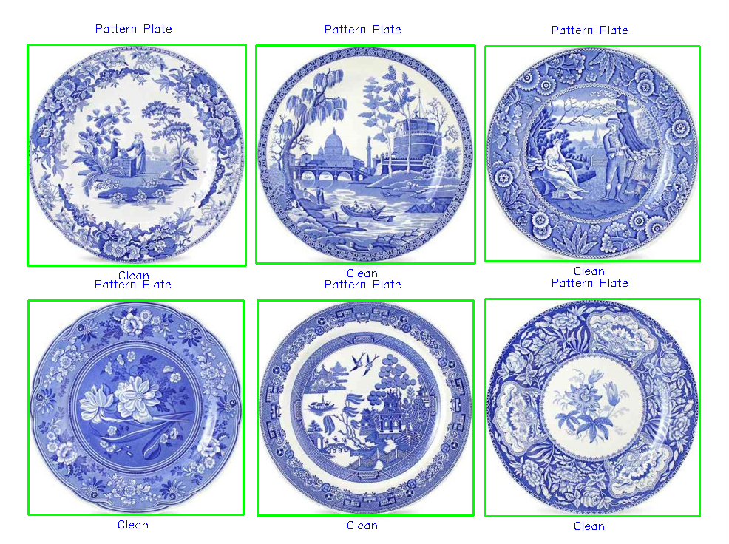
Version 2 output for pattern detection:

Slide 10
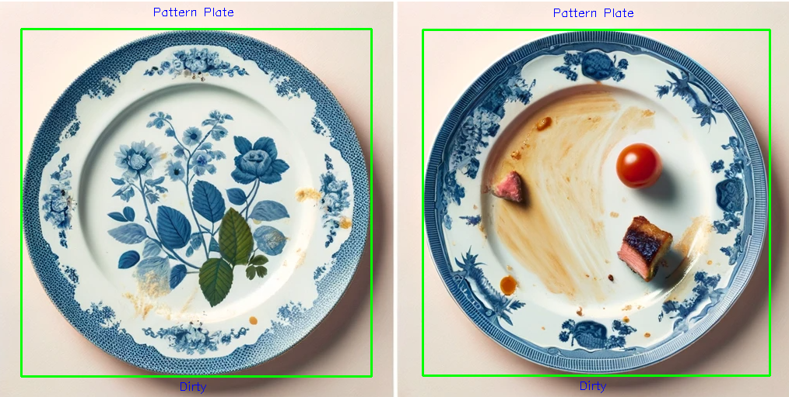
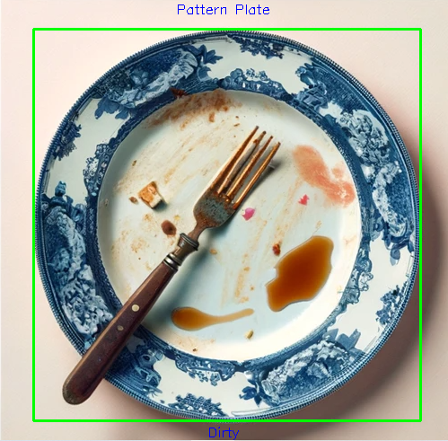
Version 2 output for pattern detection:

Slide 11
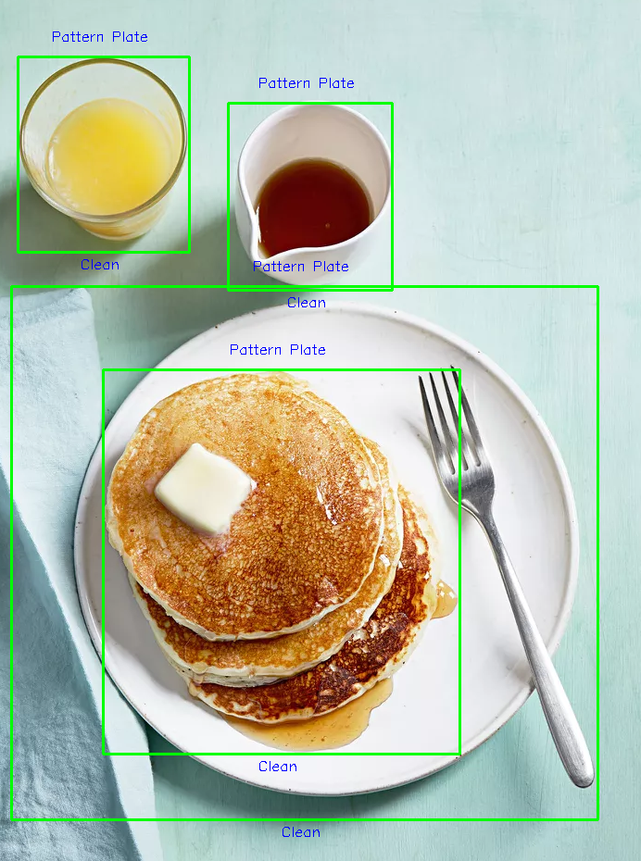
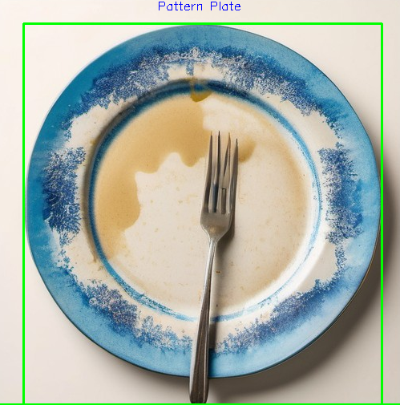
What’s next?
Work on cleaning up the plate detection
If there are different circular or oval shaped object it will be detected as a plate
If there are utensils on the plate it can also disrupt the edge detection for plate detection.
Work on refactoring pattern plates cleanliness detection
If there are both clean and dirty plates in an image its has issues detecting which are clean and dirty due to the threshold differences.
Possibly use a different method as intensity mean comparing will not work with a variety of different patterned plates.

Slide 12
Bibliography
https://www.youtube.com/watch?v=ram-jbLJjFg&list=PL2zRqk16wsdqXEMpHrc4Qnb5rA1Cylrhx&index=16
https://stackoverflow.com/questions/22722772/how-to-use-sift-in-opencv
https://docs.opencv.org/3.4/d7/d4d/tutorial_py_thresholding.html
https://docs.opencv.org/4.x/d5/d38/group__core__cluster.html

